Slide 1
Breast Cancer Risk Assessment Using Logistic Regression
Orbin Ahmed Acanto

Slide 2
Problem Statement
Breast cancer is one of the leading causes of cancer-related deaths worldwide.
Early detection and classification are crucial for improving survival rates.
There are two major types of breast cancer (e.g., malignant vs. benign).
Goal: Develop a machine learning model to classify breast cancer types based on clinical and histological features.

Slide 3
Dataset Overview
Source: UCI ML Repository (https://archive.ics.uci.edu/dataset/17/breast+cancer+wisconsin+diagnostic)
Number of samples: 569
Target Variable (Diagnosis):
"M" → Malignant (cancerous)
"B" → Benign (non-cancerous)
Features: The dataset consists of 30 numerical features derived from breast cancer cell nuclei characteristics, grouped into three categories:
Mean Measurements
Standard Error Measurements
Worst (Max) Value Measurements
The dataset contains numerical features and a categorical target variable
The feature values extracted from digital images of fine needle aspirate (FNA) biopsies of breast masses.

Slide 4
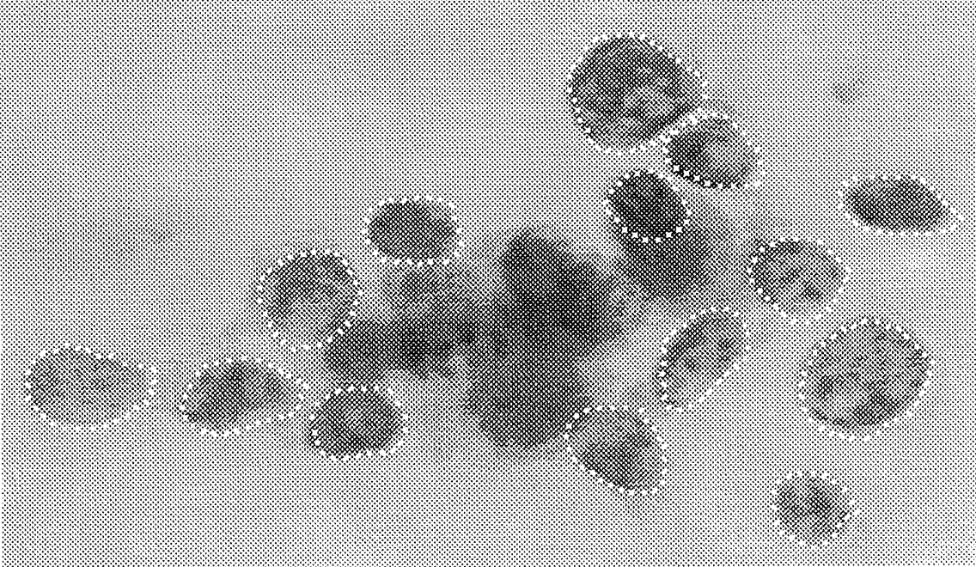
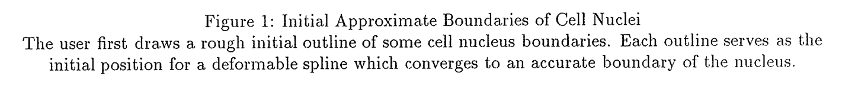
Street, William Nick et al. “Nuclear feature extraction for breast tumor diagnosis.” Electronic imaging (1993).

Slide 5
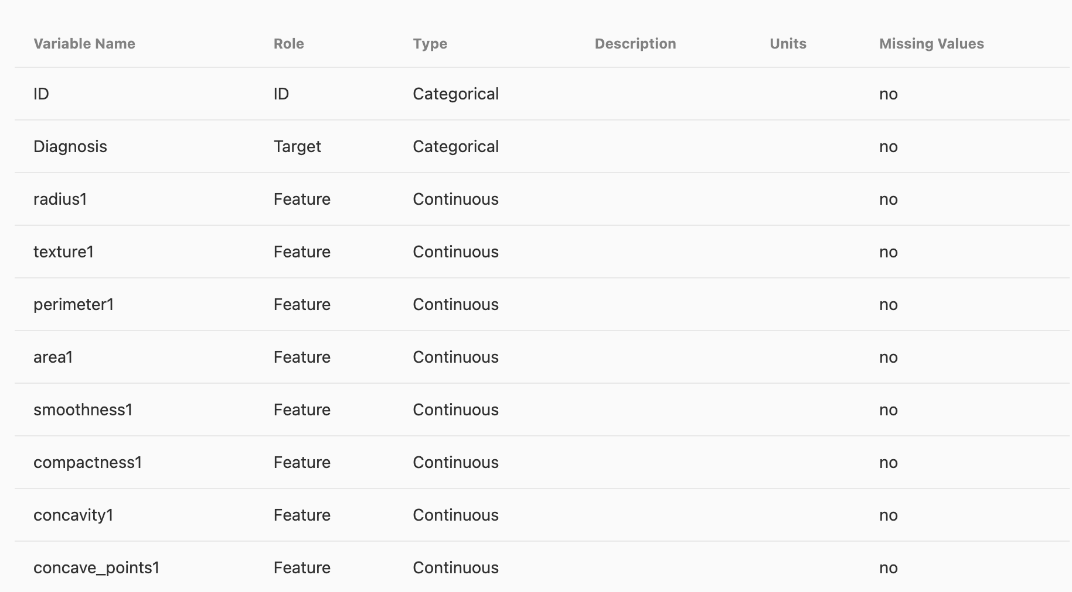
Variables

Slide 6
Analytical Techniques & Informatics Methods
Machine Learning Model
Logistic Regression:
Binary classification model (malignant vs. benign).
Provides probabilistic cancer risk assessment.
Interpretable model useful for medical applications.
Data Preprocessing Steps
Data Normalization: Scaling features (0-1) to ensure model efficiency.
Drop some variable which are does not have significant effect over target variables
Data set Balancing: SMOTE
Splitting Dataset: 70% Training | 15% Validation | 15% Testing for model evaluation.

Slide 7
Software & Tools
Programming Language
Python (preferred for ML & data analysis)
ML Frameworks & Libraries
scikit-learn: Model development (Logistic Regression)
pandas & NumPy: Data preprocessing & analysis
imbalanced-learn: For class balancing
matplotlib & seaborn: Data visualization
Jupyter Notebook: Experimentation environment
Outcomes: A highly interpretable model for breast cancer classification.

Slide 8
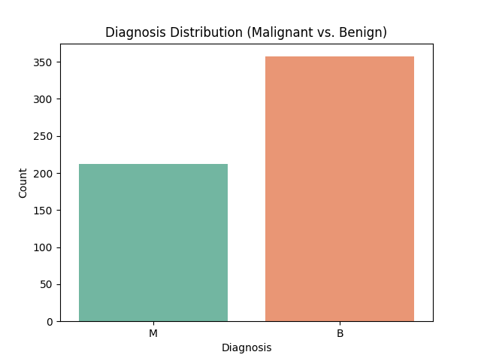
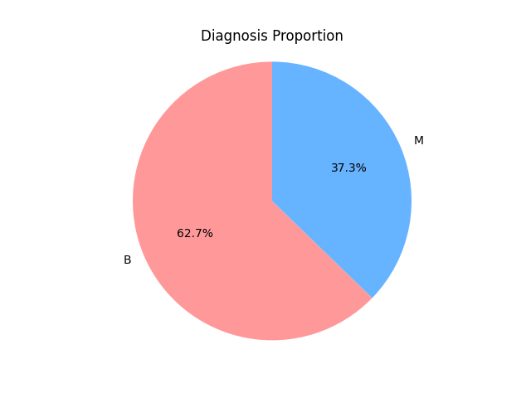
Diagnosis Distribution: Class Balance Overview
Malignant (M): 212 cases (~37.3%)
Benign (B): 357 cases (~62.7%)
This dataset contains 569 breast cancer cases, labeled as either Malignant (M) or Benign (B).

Slide 9
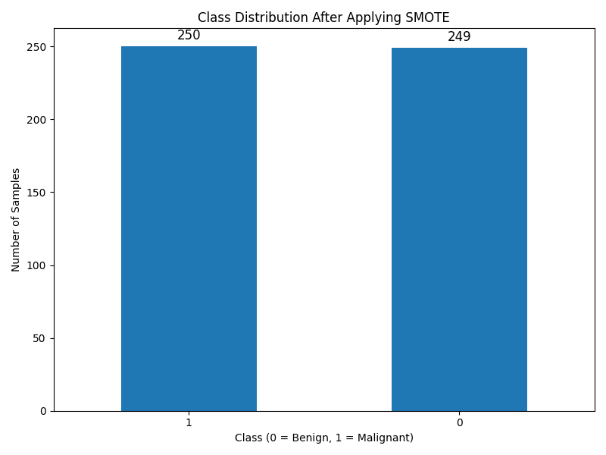
Diagnosis Distribution: Class Balance Overview (After applying SMOTE)
Train Set
Malignant (1): 250 cases (~50%)
Benign (0): 249 cases (~50%)
Test Set / Valid Set
Malignant (1): 54 cases (~50%)
Benign (0): 53 cases (~50%)
New dataset contains 714 breast cancer cases, labeled as either Malignant (1) or Benign (0).

Slide 10
Result
Model | Dataset | Accuracy (%) | Precision (Benign) | Recall (Benign) | Precision (Malignant) | Recall (Malignant)
Logistic Regression | Validation | 96.26 | 0.95 | 0.98 | 0.98 | 0.94
Random Forest | Validation | 98.13 | 0.96 | 1.00 | 1.00 | 0.96
Logistic Regression | Test | 98.39 | 0.98 | 0.99 | 0.99 | 0.98
Random Forest | Test | 100.00 | 1.00 | 1.00 | 1.00 | 1.00

Slide 11
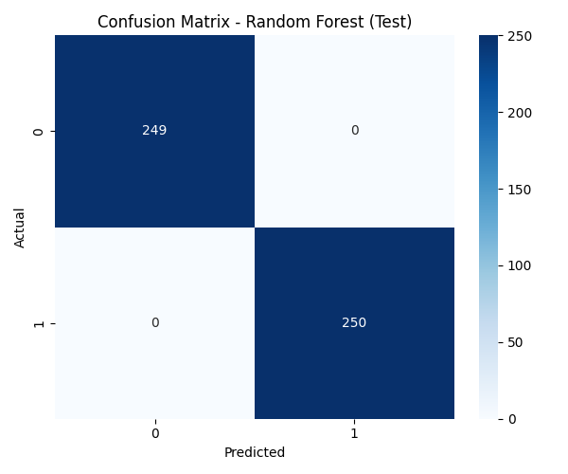
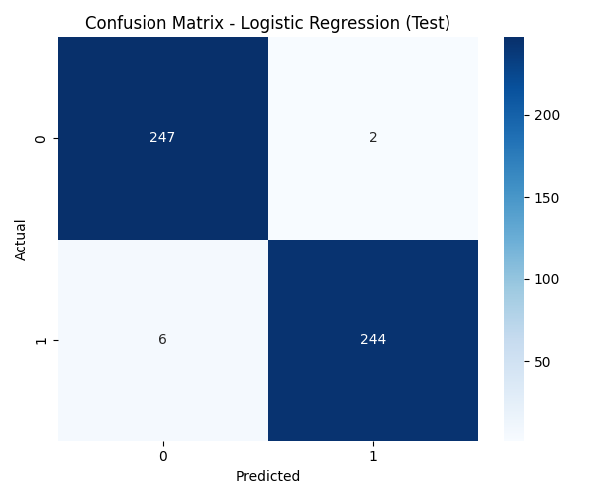

Slide 12
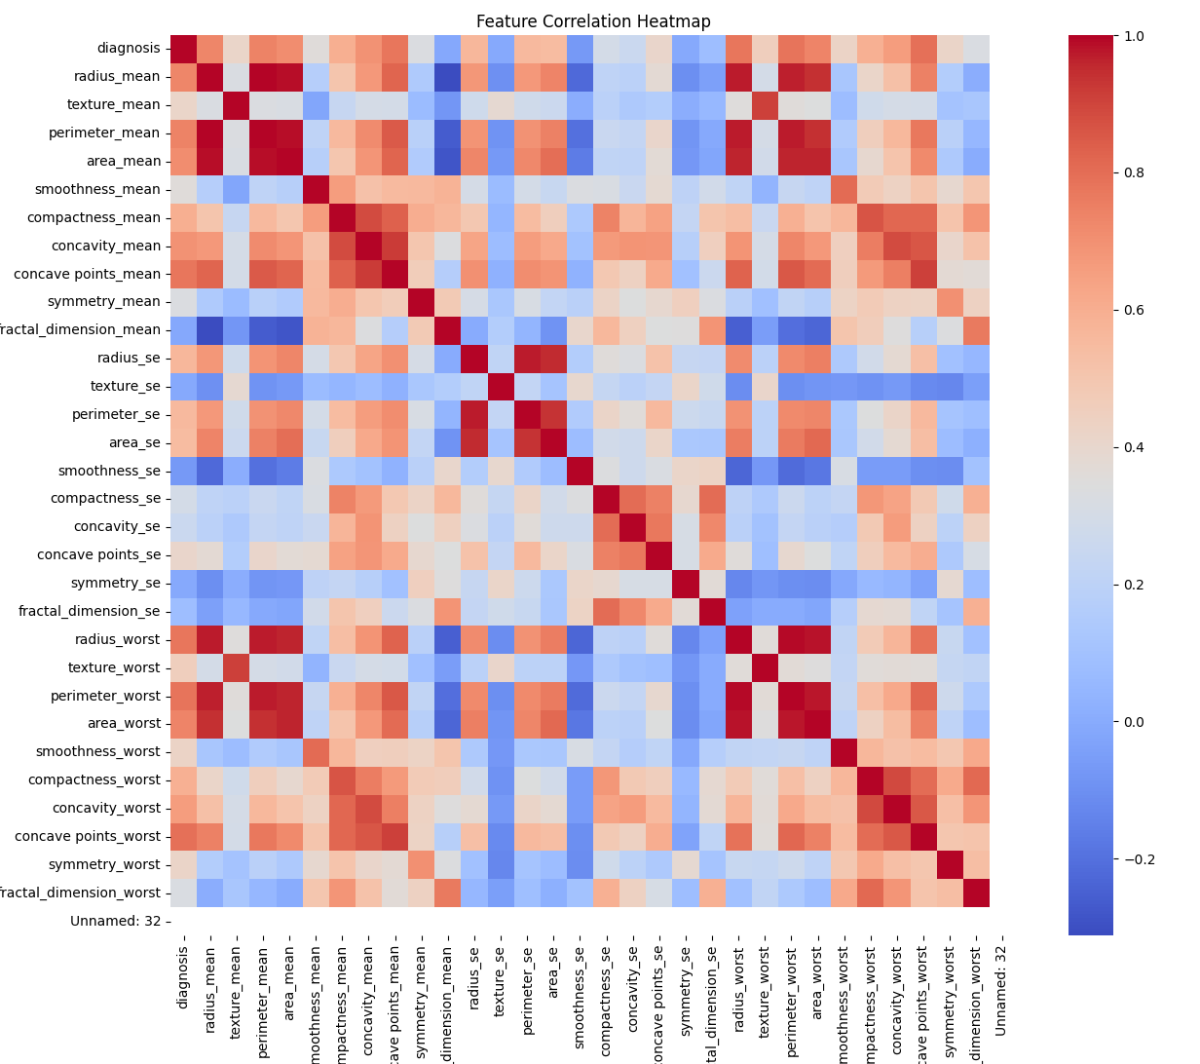
Feature Correlation Heatmap
A heatmap was generated to understand how features relate to each other and the target (diagnosis).
Red indicates strong positive correlation, blue indicates negative correlation, and lighter shades indicate weaker correlations.
Some features are highly correlated with the target (like radius, area, concavity).
This insight will help in feature selection, reducing noise and improving model performance.

Slide 13
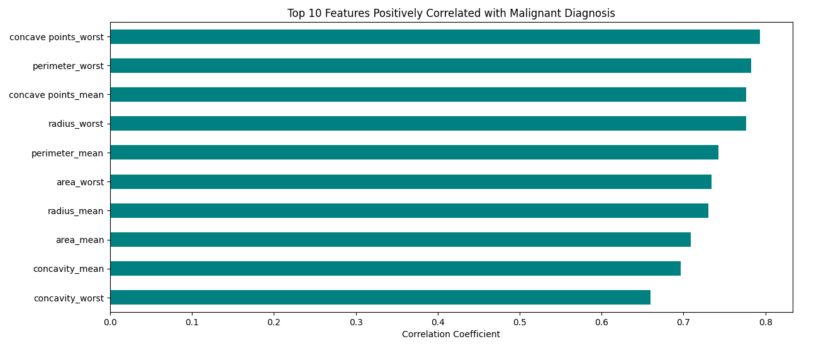
Top Predictive Features

Slide 14
Model Evaluation
Train-Test Strategy:
Dataset split: 70% training, 15% testing, 15% validation
Stratified split to preserve class distribution
Evaluation Metrics:
Accuracy: Overall model correctness
Precision: Correctly identified malignant cases among predicted malignant
Recall (Sensitivity): Malignant cases correctly detected
F1 Score: Balance of precision and recall

Slide 15
Result (Top 10 Features)
Experiment | Features | Logistic Regression (Test Acc) | Random Forest (Test Acc)
All Features (30) | 30 | 98.39% | 100%
Top 10 Correlated Features Only | 10 | 94.79% | 100%
Random Forest is extremely robust, it performed perfectly with both 30 and 10 features.
Logistic Regression benefits from more features to maintain very high accuracy.
Feature selection simplifies models but sometimes costs small accuracy loss for simpler models like Logistic Regression.
Training time becomes faster with fewer features.

Slide 16
Thank You.

